Slide 1
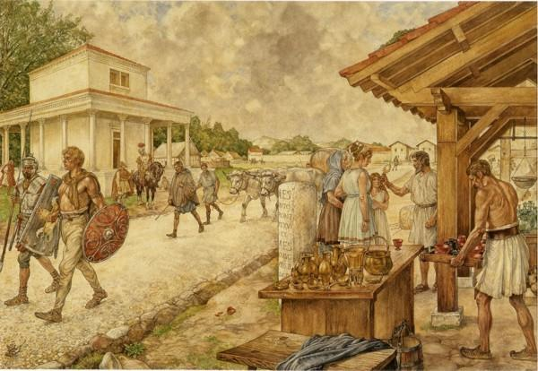
The age of Greeks and Romans
3.5 Romanisation

Slide 2
Lesson Plan
Welcome Magister
Lesson plan
The Question of today
Recap – 3.4
Romanisation
Recap (notes)
Homework
Ending
Introduction
Lesson plan
The Question
Recap
Romanisation
Recap (notes)
Homework
Ending

Slide 3
Lesson Goals
Introduction
Lesson plan
The Question
Recap
Romanisation
Homework
Ending
The question of today is:
How did the Roman culture spread across the whole empire?

Slide 4
Recap
Introduction
Lesson plan
The Question
Recap
Romanisation
Homework
Ending
Emperors in power:
Causes:
Professional Army
Caeser becomes a dictator
Caeser gets murdered
Augustus takes full control and restores the peace -> Pax Romana

Slide 5
Romanisation
The Roman Culture expands:
Roman soldiers conquered regions and settled there together with Roman administrators;
Soldiers lived in Army camps and took wives in the region;
Conquered people could join the Roman Army if they want to become Roman Citizens;
Rome builds temples and public buildings in existing towns;
(Roads, Bathhouses, temple’s, Aquaducts)
Romans who stayed behind started farming businesses and employed local population;
Roman Citizens:
The wives and children of soldiers got Civil Rights and became Roman Citizens;
Roman Citizens had privileges;
Lower Tax;
Could claim higher positions;
Had more rights in Court
Introduction
Lesson plan
The Question
Recap
Romanisation
Homework
Ending

Slide 6
Romanisation – Roman culture
What was the Roman culture?
After the conquest of Greece in the 200 B.C. the Romans copied much of the Greek style.
Think of Architecture, sculpture, poetry and the use of olive oil.
They also took over their Religion.
Greek gods were given Roman names:
Zeus - > Jupiter
Hera -> Juno
Ares -> Mars
Their own culture:
Latin, Toga’s and the use of numerals.
Amphitheatres.
Introduction
Lesson plan
The Question
Recap
Romanisation
Homework
Ending

Slide 7
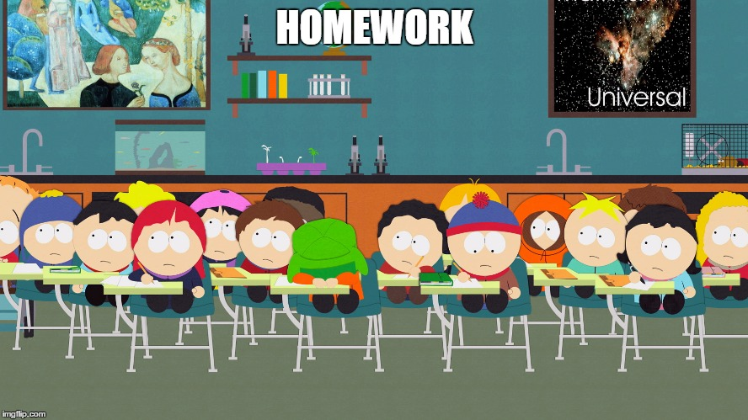
Homework
Introduction
Lesson plan
The Question
Recap
Worksheet
Finding of Rome
Roman Republic
Recap (notes)
Homework
Ending
Make questions 3 to 8:
15 minutes
We will discuss the anwsers after 15 minutes.
Homework:
Read and Learn Chapter 3.5
Make Questions 3 to 8

Slide 8
Ending
What Sticks?
Next week: Test about 3.1 to 3.5

